Slide 1
financial insights and investment strategy actual vs budget VARIANCE ANLYSIS
By
Dr. Uzma Abdullah

Slide 2
Project overview
Performance variance overview
Cost analysis for repair and maintenance
Cost analysis utilities
Sensitivity analysis
Strategic investment recommendations

Slide 3
Executive Summary
Performance exceeded expectations with Net Operating Income 63% above budget.
Revenue outperformed by $612K (+5%), driven by stronger base rent and lower concessions.
Total expenses were slightly below budget (-1%), despite higher R&M.
NOI variance: +$1.95M over budget.
Key risk: repairs & maintenance overspending.
Overall: A very strong quarter with revenue resilience and disciplined cost control.

Slide 4
Income Section
Base Rent (+$800,300 / +7%)
• Actual rent collected is higher than budgeted.
• Variance: Likely due to stronger leasing performance, fewer vacancies, or higher negotiated rents.
Free Rent (–$280,000 / –35%)
• Free rent (concessions) given is lower than budgeted.
• Variance: Positive impact: tenants accepted fewer incentives than anticipated.
Recoveries (+$92,000 / +17%)
• Higher tenant recoveries for CAM (common area maintenance) and property expenses.
• Variance: Indicates higher pass-through costs billed to tenants.
Effective Gross Revenue (+$612,300 / +5%)
• Variance: Overall revenue exceeded budget because of higher rent and recoveries while free rent costs were lower.

Slide 5
EXPENSES SECTION
Repairs & Maintenance (R&M) (+$384,100 / +37%)
• Actual maintenance costs significantly exceeded budget.
• Variance: Possible causes: unexpected repairs, inflation in material/labor, or accelerated maintenance projects.
Utilities (–$156,000 / –7%)
• Lower than budgeted, indicating savings.
• Variance: Could be from energy efficiency, favorable rates, or reduced usage.

Slide 6
Property Taxes & Insurance (–$100,000 / –3%)
• Slightly under budget.
• Variance: May be due to revised assessments, lower premiums, or timing differences.
Management & Administration (–$89,300 / –17%)
• Below budget, meaning savings in admin or management fees.
• Variance: Could be staff cost savings or reduced overhead.
Total Expenses (+$1,018,800 / +14%)
• Variance: Despite some savings, overspending in R&M drove total expenses over budget.

Slide 7
SUMMARY TABLE
Category | Variance ($) | Variance (%) | Explanation
Base Rent | 800,300 | +7% | Higher than budget due to stronger leasing performance, fewer vacancies, or higher negotiated rents.
Free Rent | -280,000 | -35% | Lower concessions than budgeted, indicating tenants accepted fewer incentives.
Recoveries | 92,000 | +17% | Higher tenant recoveries for CAM and property expenses billed back to tenants.
Effective Gross Revenue | 612,300 | +5% | Revenue exceeded budget due to higher rent and recoveries, with reduced concessions.
Repairs & Maintenance | 384,100 | +37% | Overspending due to unexpected repairs, inflation in materials/labor, or accelerated maintenance.

Slide 8
Utilities | -156,000 | -7% | Lower than budget from savings in energy usage, favorable rates, or efficiency measures.
Property Taxes & Insurance | -100,000 | -3% | Slightly below budget due to lower premiums, revised assessments, or timing differences.
Management & Administration | -89,300 | -17% | Savings in admin or management fees, reduced overhead, or staff cost savings.
Total Expenses | 1,018,800 | +14% | Overall above budget, driven mainly by overspending in Repairs & Maintenance.
Net Operating Income | 1,953,500 | +63% | Significantly above budget due to higher revenues despite higher expenses.

Slide 9
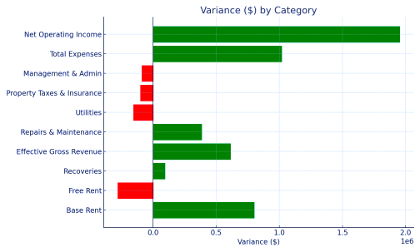
VARIANCE GRAPH BY CATEGORY

Slide 10
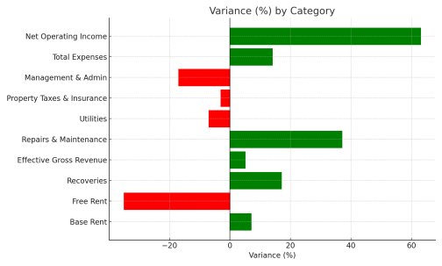
VARIANCE (%) BY CATEGORY

Slide 11
SUMMARY
Net Operating Income (NOI) (+$1,953,500 / +63%)
NOI significantly outperformed the budget.
Driven by higher revenues and despite higher expenses, overall profitability was much stronger than expected.
Driven by higher revenues and despite higher expenses, overall profitability was much stronger than expected.

Slide 12
Sensitivity Analysis Unlevered IRR (5-Year Office Investment)
Unlevered IRR is the Internal Rate of Return before debt financing i.e., pure equity returns, no loans, only investor return on their own capital financing on property.
Financial Performance & Investment Recommendation
A tool that tests how changes in key assumptions affect investment returns.
• Uses Sale Year (rows) when property is sold and Sale Price (columns), at what price its sold, ($65M to $75M)
• Helps identify optimal timing and price strategy to maximize IRR.

Slide 13
Frame work of financial model
Purchase Price: $55,000,000 (assumed cost to acquire property, its baseline investment against which sale proceeds and returns are measured.
Sale Price Range: $65M – $75M ( expected range of resale values tested in model with lower-end market scenario to optimistic upper case, showing uncertainty in future market pricing)
Sale Years Tested: 1 – 5 ( Investors see the effect of timings on returns)
Debt as % of Acquisition: 60% (assumes 60% of the purchase price is financed with debt loan, while 40% is equity from investors). Effecting levered IRR, higher potential return but higher risk due to interest payments.
Debt Interest Rate: 5% ( the cost of borrowing on the 60% debt portion is $55 M financing on 5% interest rate , low borrowing cost boosts investor return by leveraging equity, but adds risk since debt service payments must be met)

Slide 14
Sensitivity Table: Unlevered IRR (%)
Sale Year | $65M | $68M | $70M | $75M
Year 1 | 38.51% | 42.98% | 46.00% | 53.74%
Year 2 | 22.08% | 24.12% | 25.47% | 28.81%
Year 3 | 15.89% | 17.23% | 18.12% | 20.27%
Year 4 | 12.52% | 13.53% | 14.19% | 15.79%
Year 5 | 10.37% | 11.19% | 11.71% | 12.99%

Slide 15
SUMMARY
Earlier Sale = Higher IRR e.g., At $70M sale price:
Year1 = 46.0% IRR. Year 5 = 11.7%,
Reason: Sooner cash received, higher the value of return (time value of money)
Higher Sale price = Higher IRR:
In Year 3: $65M = 15.9% IRR
$75M = 20.3% IRR
Reason: Every extra $5-10M in sale price significantly improves returns.
Strategic take away Best Case is selling Earlier (Year1 or Year 2 yields very high IRR, Moderate Case is Mid-hold (Year 3) stabilizes the returns
IRR declines over time – early sales deliver higher returns, Worst Case: Holding until Year 5 drops IRR close to 10-13% even at strong prices.

Slide 16
Recommendation
The sensitivity table highlights that both sale timings and price matters, but delaying sale erodes IRR significantly even at higher prices.
Target sale in Year 2 at $75M for 28.81% IRR. Allows early reinvestment of profits into new opportunities and earlier exits deliver stronger investor returns.
Mitigates risk of declining IRR over longer holding periods and suggest holding until market evidence strongly supports much higher prices in future.

Slide 17
THANK YOU

